Slide 1
Critical Theory
REPRESENTING THE PHILOSOPHY THROUGH ART
By Cynthia Aguirre

Slide 2

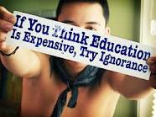
EMPOWERING THE POWERLESS:TRANSFORMING INEQUALITIES

Slide 3

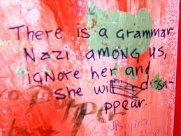
New language should be created to deconstruct dominant power

Slide 4

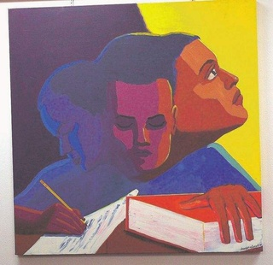
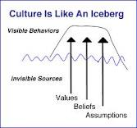
Empower+ Transform+ Cultural factors

Slide 5
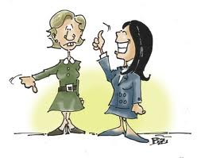

Teachers negotiate to help empower
Not this But this

Slide 6


Curriculum inspires learning when it’s built on cultural knowledge that is already possessed

